Slide 1
Injection

Slide 2
Objectives
Acquire familiarity with OWASP Top 10 – 2017 and how flaws were ranked.
A1:2017 Injection Flaws
Introduction to Injection flaws
Introduction to SQL Injection
Simple SQL Injection examples
More advanced SQL Injection techniques
Remedies

Slide 3
OWASP
The Open Web Application Security Project (OWASP) is an open community dedicated to enabling organizations to develop, purchase, and maintain applications and APIs that can be trusted.
OWASP offers open resources (e.g., tools, documents, videos, presentations) about how to improve application security.
Notes:
Resources include application security tools and standards; complete books on application security testing, secure code development and secure code reviews; presentations and videos; cheat sheets in many common topics Local chapters worldwide; Extensive conferences worldwide; mailing lists

Slide 4
OWASP Top 10 - 2017
Aims: educate developers, designers, architects, managers, and organizations about the consequences of the most common and important web application security weaknesses.
Surveys vulnerabilities gathered from hundreds of organizations and over 100K real-world applications and APIs
The top 10 vulnerabilities are selected according to
prevalence of data in combination with consensus
estimates of exploitability, detectability, and impact
https://www.owasp.org/images/7/72/OWASP_Top_10-2017_%28en%29.pdf.pdf
Notes:
Organizations from which vulnerabilities were surveyed are firms that specialize in application security

Slide 5
Risk Rating System
Risk = Likelihood * Impact
https://www.owasp.org/images/7/72/OWASP_Top_10-2017_%28en%29.pdf.pdf
Notes:
Organizations from which vulnerabilities were surveyed are firms that specialize in application security

Slide 6
Risk Rating System
Risk = Likelihood * Impact
Exploitability
Detectability
Prevalence
https://www.owasp.org/images/7/72/OWASP_Top_10-2017_%28en%29.pdf.pdf
Notes:
To ensure repeatability of the methodology it was necessary to look at different likelihood and impact factors

Slide 7
Risk Rating System
Risk = Likelihood * Impact
Exploitability
Detectability
Prevalence
Technical Impact
Business Impact
Technical Impact: Loss of confidentiality, integrity, availability and accountability.
https://www.owasp.org/images/7/72/OWASP_Top_10-2017_%28en%29.pdf.pdf
Notes:
To ensure repeatability of the methodology it was necessary to look at different likelihood and impact factors

Slide 8
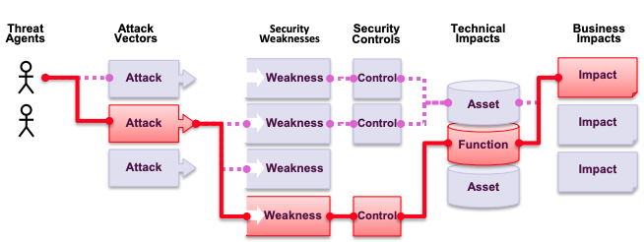
Risk Rating System
Exploitability
Prevalence
Detectability
https://www.owasp.org/images/7/72/OWASP_Top_10-2017_%28en%29.pdf.pdf
Notes:
To ensure repeatability of the methodology it was necessary to look at different likelihood and impact factors

Slide 9
Risk Rating System
Risk = Likelihood * Impact
Exploitability
Detectability
Prevalence
Technical Impact
Business Impact
A Top 10 likelihood of existence list by prevalence is created
https://www.owasp.org/images/7/72/OWASP_Top_10-2017_%28en%29.pdf.pdf
Notes:
To ensure repeatability of the methodology it was necessary to look at different likelihood and impact factors

Slide 10
Risk Rating System
Risk = Likelihood * Impact
Exploitability
Detectability
Prevalence
Technical Impact
Business Impact
A Top 10 likelihood of existence list by prevalence is created
This data was then combined with the other two likelihood factors (detectability and ease of exploit) to calculate a likelihood rating for each weakness.
Detectability, Ease of Exploit, and Impact were calculated from analyzing reported CVEs that were associated with each of the Top 10 categories.
Notes:
To ensure repeatability of the methodology it was necessary to look at different likelihood and impact factors

Slide 11
Risk Rating System
Risk = Likelihood * Impact
Exploitability
Detectability
Prevalence
Technical Impact
Business Impact
The likelihood rating was then multiplied by the estimated average technical impact for each item to come up
with an overall risk ranking for each item in the Top 10 (the higher the result the higher the risk).
https://www.owasp.org/images/7/72/OWASP_Top_10-2017_%28en%29.pdf.pdf
Notes:
To ensure repeatability of the methodology it was necessary to look at different likelihood and impact factors

Slide 12
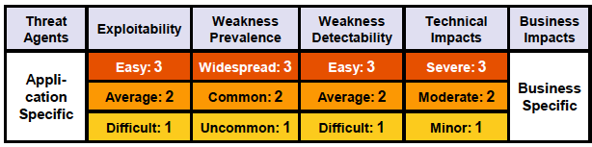
Risk Rating System
https://www.owasp.org/images/7/72/OWASP_Top_10-2017_%28en%29.pdf.pdf
Notes:
To ensure repeatability of the methodology it was necessary to look at different likelihood and impact factors

Slide 13
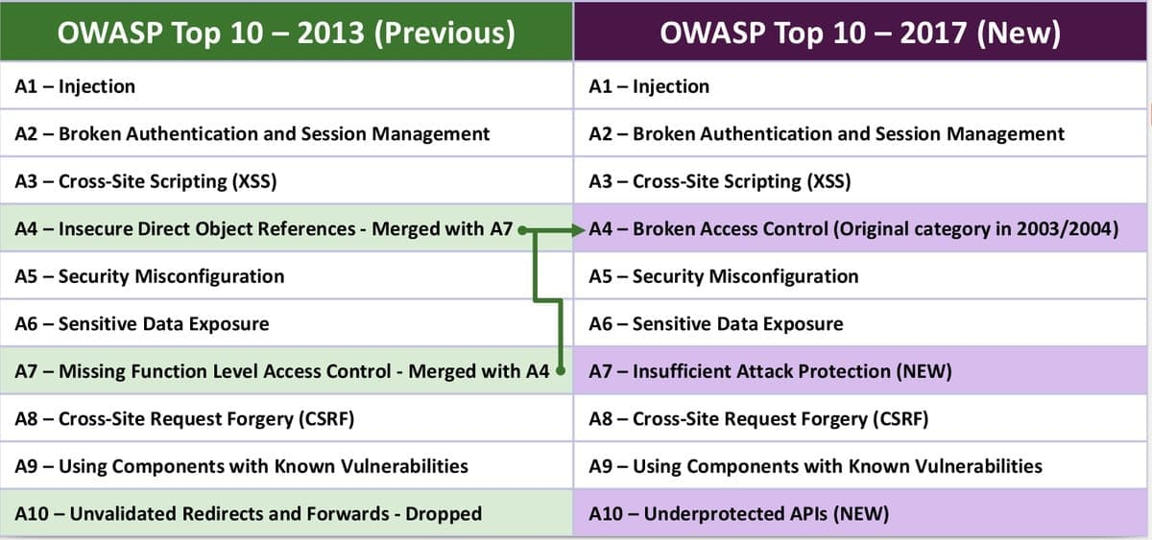
https://www.owasp.org/images/7/72/OWASP_Top_10-2017_%28en%29.pdf.pdf

Slide 14
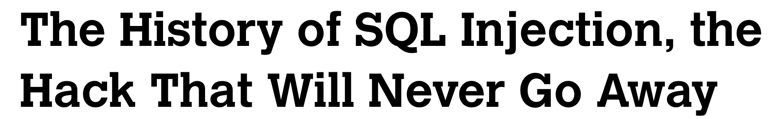
A1:2017 - Injection
“It is effective”
Allows injecting malicious commands to a database into forms on a website.
“It is the easiest way to hack”
Attacks typically take a few hours.
Notes:
It's been used to steal the personal details of World Health Organization employees, grab data from the Wall Street Journal, and hit the sites of US federal agencies. 'It's the most easy way to hack,' the pseudonymous hacker w0rm, who was responsible for the Wall Street Journal hack, told Motherboard. The attack took only a 'few hours.' But, for all its simplicity, as well as its effectiveness at siphoning the digital innards of corporations and governments alike, SQLi is relatively easy to defend against. So

Slide 15
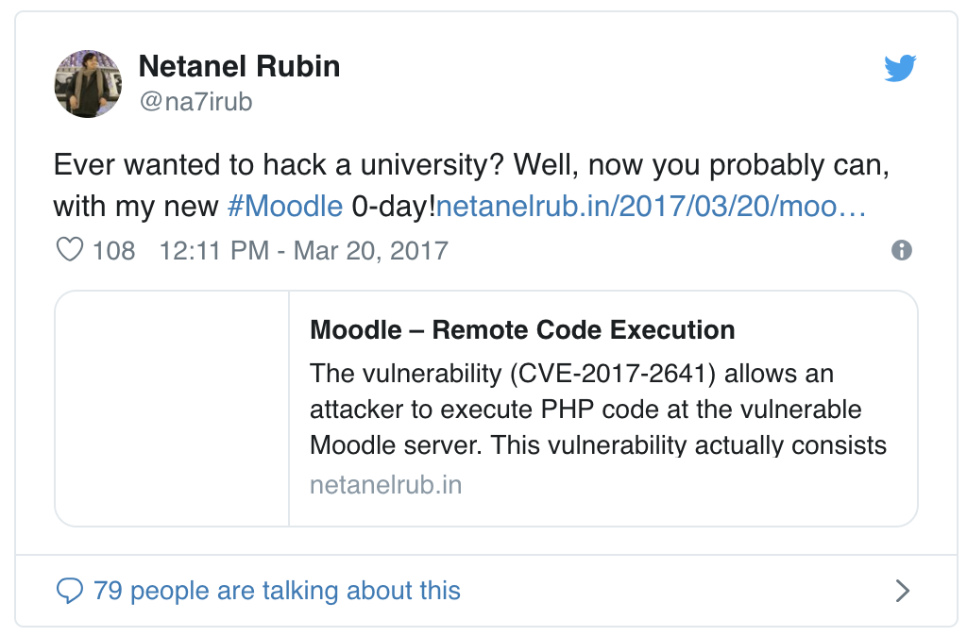

A SQL injection vulnerability–could be used by an attacker to execute PHP code on a university’s server

Slide 16
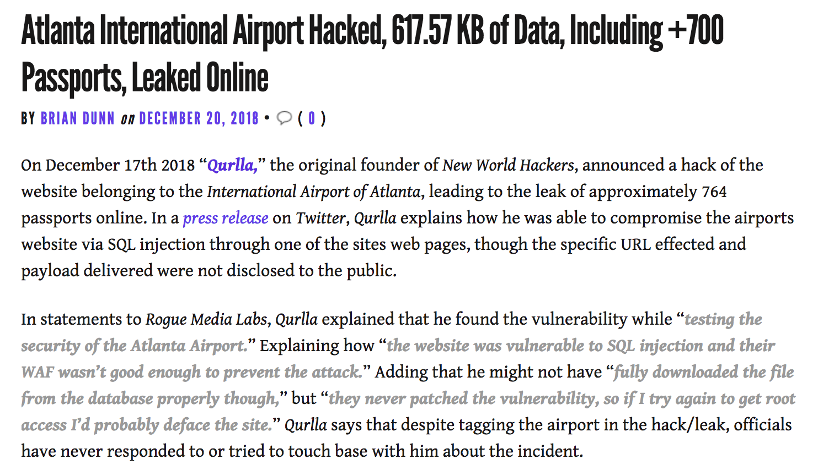
https://roguemedialabs.com/2018/12/20/atlanta-international-airport-hacked-617-57-kb-of-data-including-700-passports-leaked-online/

Slide 17
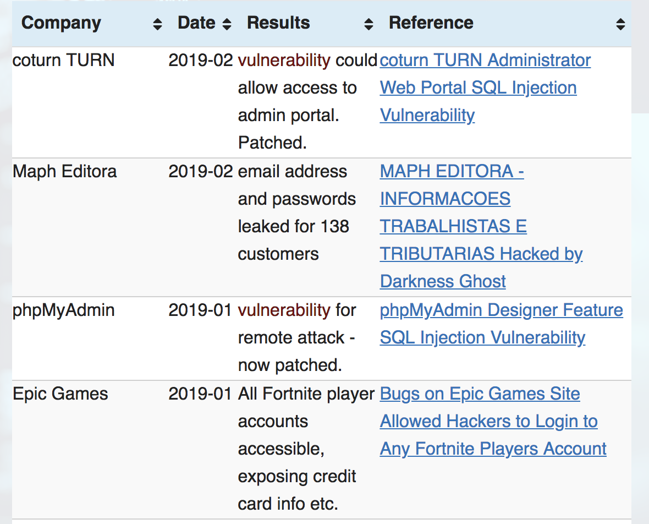
… And Many More
Check MySQL Injection Hall of Shame
https://codecurmudgeon.com/wp/sql-injection-hall-of-shame/

Slide 18
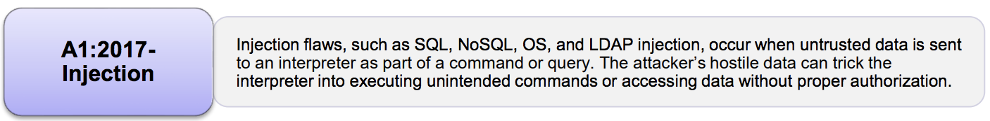
A1:2017 - Injection
Injection flaws allow attackers to relay malicious code through an application to another system:
calls to backend databases via SQL (i.e., SQL injection);
calls to the operating system via system calls;
use of external programs via shell commands.
Any time an application uses an interpreter of any type there is a danger of introducing an injection vulnerability.
https://www.owasp.org/images/7/72/OWASP_Top_10-2017_%28en%29.pdf.pdf
Notes:
Whole scripts written in Perl, Python, and other languages can be injected into poorly designed applications and executed.

Slide 19
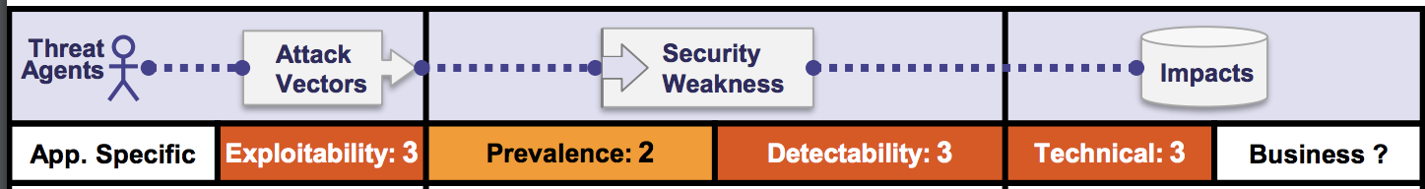
Exploitability
Almost any source of data can be an injection vector:
Environment variables
Parameters
External and internal web services
All types of users.
https://www.owasp.org/images/7/72/OWASP_Top_10-2017_%28en%29.pdf.pdf

Slide 20
Prevalence & Detectability
Often found in SQL, LDAP, XPath, or NoSQL queries, OS commands, XML parsers, SMTP headers, expression languages, and ORM queries.
Prevalent also in legacy code
Injection flaws are easy to discover when examining code.
Scanners and fuzzers can help attackers find injection flaws.
Notes:
Fuzz testing (fuzzing) is a quality assurance technique used to discover coding errors and security loopholes in software, operating systems or networks. It involves inputting massive amounts of random data, called fuzz, to the test subject in an attempt to make it crash.

Slide 21
Technical Impact
Loss of Integrity: data loss and/or corruption
Loss of Confidentiality: disclosure of data to unauthorized parties
Loss of availability: denial of access; Injection can sometimes lead to complete host takeover.
Loss of accountability:
The business impact depends on the needs of the application and data.

Slide 22
SQL Injection Attack

Slide 23
SQLInjection Attack
Insertion or “injection” of malicious data via the SQL query input from the client to the application.
A successful SQL injection exploit can:
read and modify sensitive data from the database;
execute administration operations on the database:
Shutdown auditing or the DBMS itself;
Truncate tables and logs
Add users
Recover the content of a given file present on the DBMS file system
Issue commands to the operating system
Notes:
The proposed ranking is based on years of experience that Gary McGraw acquired by applying touchpoints to many different types of organizations ranging from independent software vendors to huge credit card consortium

Slide 24
Consequences of SQL Injection
SQL injection attacks allow attackers to:
Spoof identity,
Tamper with existing data
cause repudiation issues such as voiding transactions or changing balances
allow the complete disclosure of all data on the system
destroy the data or make it otherwise unavailabale, and become administrators of the database server
SQL Injection is more common in PHP, classic ASP, Cold Fusion and older languages:
Languages that do not provide parameterized query support
Parameterized queries have been added to newer versions
Early adopters of web technology (i.e. Old Code)

Slide 25
Severity of SQL Injection
The severity of SQL Injection attacks is limited by
Attacker’s skill and imagination
Defense in depth countermeasures:
Input validation
Least privilege
Database technology
Not all databases support command chaining
Microsoft Access
MySQL Connector/J and C
Oracle

Slide 26
Example of SQL Injection
Dynamic query in application
Potential String Injection
Potential Numeric Injection
Notes:
The proposed ranking is based on years of experience that Gary McGraw acquired by applying touchpoints to many different types of organizations ranging from independent software vendors to huge credit card consortium

Slide 27
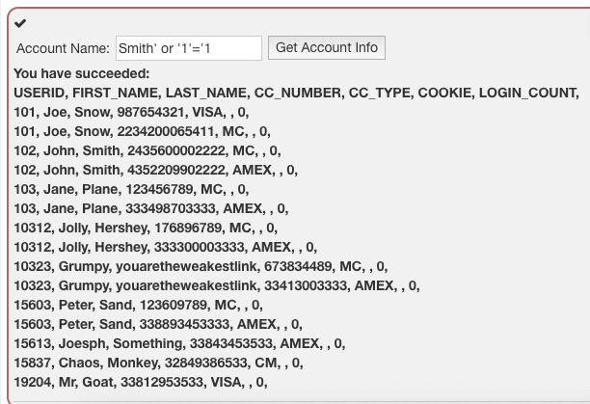
String Injection
Attacker supplies unexpected text
select * from users where name = ‘Smit’ or ‘1’ = ‘1’
Notes:
The proposed ranking is based on years of experience that Gary McGraw acquired by applying touchpoints to many different types of organizations ranging from independent software vendors to huge credit card consortium

Slide 28
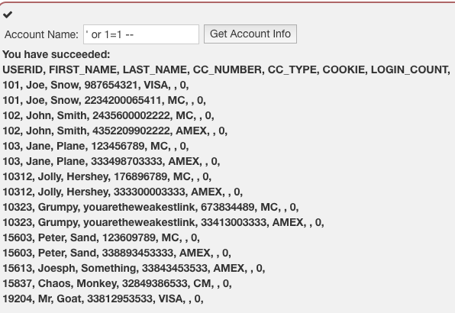
String Injection
Attacker supplies unexpected text
select * from users where name = ‘’ or 1 = 1--’;
Notes:
The proposed ranking is based on years of experience that Gary McGraw acquired by applying touchpoints to many different types of organizations ranging from independent software vendors to huge credit card consortium

Slide 29
String Injection
Attacker supplies unexpected text
select * from users where name = ‘’ or 1 = 1--’;
Notes:
The proposed ranking is based on years of experience that Gary McGraw acquired by applying touchpoints to many different types of organizations ranging from independent software vendors to huge credit card consortium

Slide 30
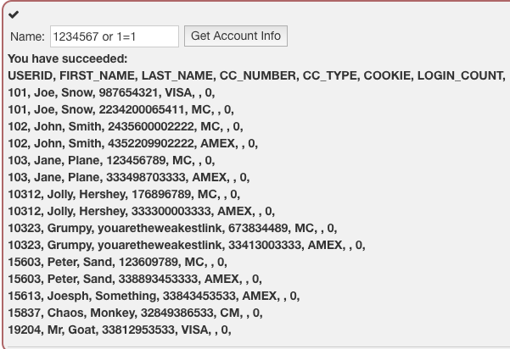
Numeric Injection
Attacker supplies unexpected text
select * from users where employee_id = 1234567 or 1=1;
Notes:
The proposed ranking is based on years of experience that Gary McGraw acquired by applying touchpoints to many different types of organizations ranging from independent software vendors to huge credit card consortium

Slide 31

String Injection
Attacker supplies unexpected text
Smith’; drop table users; truncate audit_log;--
select * from users where name = ‘Smith’; drop table users; truncate audit_log;--’;
Notes:
The proposed ranking is based on years of experience that Gary McGraw acquired by applying touchpoints to many different types of organizations ranging from independent software vendors to huge credit card consortium

Slide 32
Try it Yourself
Download Webgoat
https://github.com/WebGoat/WebGoat/releases
Execute it
java -jar webgoat-server-8.0.0.VERSION.jar [--server.port=8080] [--server.address=localhost]
Using your Browser go to:
http://localhost:8080/WebGoat/start.mvc#lesson/SqlInjection.lesson/6
Notes:
The proposed ranking is based on years of experience that Gary McGraw acquired by applying touchpoints to many different types of organizations ranging from independent software vendors to huge credit card consortium

Slide 33
Test For SQLInjection
Understand when the application interacts with a DB Server in order to access some data.
Authentication forms: when authentication is performed using a web form, chances are that the user credentials are checked against a database that contains all usernames and password
Search engines: the string submitted by the user could be used in a SQL query that extracts all relevant records from a database
E-Commerce sites: the products and their characteristics (price, description , availability, etc.) are very likely to be stored in a database
Notes:
The proposed ranking is based on years of experience that Gary McGraw acquired by applying touchpoints to many different types of organizations ranging from independent software vendors to huge credit card consortium

Slide 34
Test For SQLInjection
The first very test usually consists of adding a single quote or a smicolon to the filed or parameter under test.
The first is used in SQL as a string terminator and, if note filtered by the application, would lead to an incorrect query. The second is used to end a SQL statement and, if it is not filtered, it is also likely to generate an error
Notes:
The proposed ranking is based on years of experience that Gary McGraw acquired by applying touchpoints to many different types of organizations ranging from independent software vendors to huge credit card consortium

Slide 35
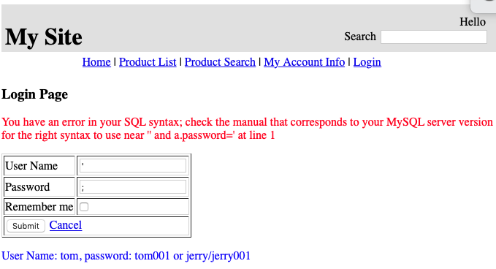
Test For SQLInjection
Notes:
The proposed ranking is based on years of experience that Gary McGraw acquired by applying touchpoints to many different types of organizations ranging from independent software vendors to huge credit card consortium

Slide 36
Try It Yourself
Download from Week 4 -> Lab Material
_menu.jsp
DBUtils.java
MySQLConnUtils.java
ProductSearchServlet.java
loginView.jsp
searchProductView.jsp
Notes:
The proposed ranking is based on years of experience that Gary McGraw acquired by applying touchpoints to many different types of organizations ranging from independent software vendors to huge credit card consortium

Slide 37
Try It Yourself
Place .jsp files in folder views
_menu.jsp
DBUtils.java
MySQLConnUtils.java
ProductSearchServlet.java
loginView.jsp
searchProductView.jsp
Notes:
The proposed ranking is based on years of experience that Gary McGraw acquired by applying touchpoints to many different types of organizations ranging from independent software vendors to huge credit card consortium

Slide 38
Try It Yourself
Place the new servlet in the servlet package
_menu.jsp
DBUtils.java
MySQLConnUtils.java
ProductSearchServlet.java
loginView.jsp
searchProductView.jsp
Notes:
The proposed ranking is based on years of experience that Gary McGraw acquired by applying touchpoints to many different types of organizations ranging from independent software vendors to huge credit card consortium

Slide 39
Try It Yourself
Replace DBUtils.java and MySQLConnUtils.java in the web application
_menu.jsp
DBUtils.java
MySQLConnUtils.java
ProductSearchServlet.java
loginView.jsp
searchProductView.jsp
Notes:
The proposed ranking is based on years of experience that Gary McGraw acquired by applying touchpoints to many different types of organizations ranging from independent software vendors to huge credit card consortium

Slide 40
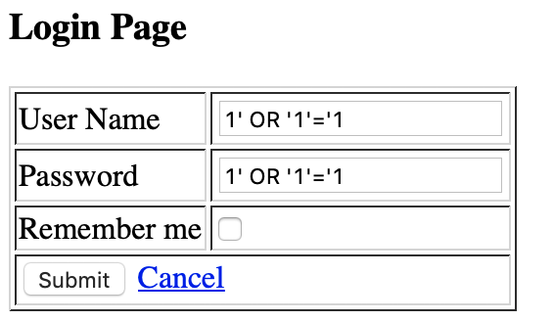
Task 1
Perform the login in your webapp without knowing username and password.
Notes:
The proposed ranking is based on years of experience that Gary McGraw acquired by applying touchpoints to many different types of organizations ranging from independent software vendors to huge credit card consortium

Slide 41
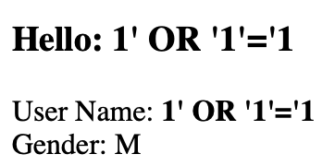
Solution
Perform the login without knowing username and password.
Notes:
The proposed ranking is based on years of experience that Gary McGraw acquired by applying touchpoints to many different types of organizations ranging from independent software vendors to huge credit card consortium

Slide 42
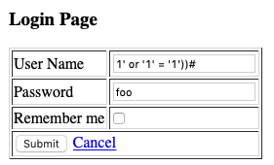
Task 2
Replace the SQL query creation with the following
String sql = "Select a.User_Name, a.Password, a.Gender from User_Account a
where ((a.User_Name = ‘"+userName+”’) and (a.password=MD5("+password+”)))"
Which query will be executed in the database?
Notes:
The proposed ranking is based on years of experience that Gary McGraw acquired by applying touchpoints to many different types of organizations ranging from independent software vendors to huge credit card consortium

Slide 43
Task 2
Replace the SQL query creation with the following
Select a.User_Name, a.Password, a.Gender from User_Account a
where ((a.User_Name = ‘1‘ OR ‘1’=‘1’))#)AND (a.Password=MD5(foo)))
Notes:
The proposed ranking is based on years of experience that Gary McGraw acquired by applying touchpoints to many different types of organizations ranging from independent software vendors to huge credit card consortium

Slide 44

Task 3 – Stacked Queries
Depending on the API that the web application is using and the DBMS it may be possible to execute multiple queries in one call.
Consider the following query:
10; INSERT INTO USERS(…)
Notes:
The proposed ranking is based on years of experience that Gary McGraw acquired by applying touchpoints to many different types of organizations ranging from independent software vendors to huge credit card consortium

Slide 45
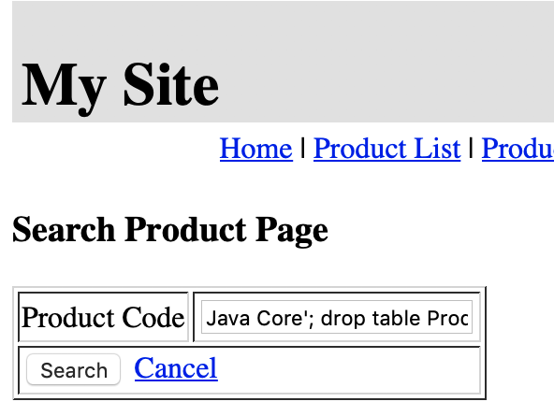
Task 3
You should now be able to delete all products in your web application.
Java Core'; drop table Product;#
Notes:
The proposed ranking is based on years of experience that Gary McGraw acquired by applying touchpoints to many different types of organizations ranging from independent software vendors to huge credit card consortium

Slide 46
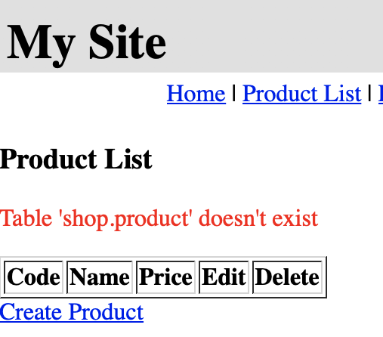
Task 3
Result: If you click Product List you can see that table Product was deleted
Notes:
The proposed ranking is based on years of experience that Gary McGraw acquired by applying touchpoints to many different types of organizations ranging from independent software vendors to huge credit card consortium

Slide 47
Advanced MySQL Injection Techniques

Slide 48
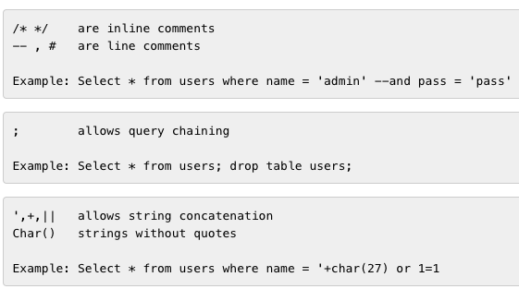
Special Characters
Notes:
The proposed ranking is based on years of experience that Gary McGraw acquired by applying touchpoints to many different types of organizations ranging from independent software vendors to huge credit card consortium

Slide 49

Special Statements
UNION
allows overlapping of database tables
Select a.CODE, a.NAME, a.PRICE from PRODUCT a where a.Name='Java Core' UNION ALL SELECT USER_NAME,PASSWORD,1 FROM USER_ACCOUNT;
Notes:
The proposed ranking is based on years of experience that Gary McGraw acquired by applying touchpoints to many different types of organizations ranging from independent software vendors to huge credit card consortium

Slide 50
Special Statements
JOIN
allows connecting results to those of other tables
Notes:
The proposed ranking is based on years of experience that Gary McGraw acquired by applying touchpoints to many different types of organizations ranging from independent software vendors to huge credit card consortium

Slide 51
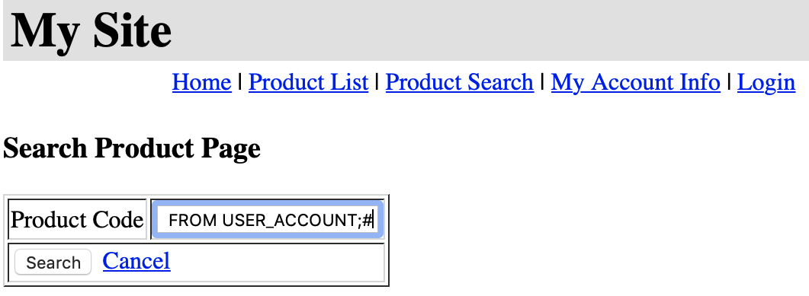
Task 4
Use the search product function in your web application to spoof the credentials of existing users.
Java Core' UNION ALL SELECT USER_NAME,PASSWORD,1 FROM USER_ACCOUNT;#
Notes:
The proposed ranking is based on years of experience that Gary McGraw acquired by applying touchpoints to many different types of organizations ranging from independent software vendors to huge credit card consortium

Slide 52
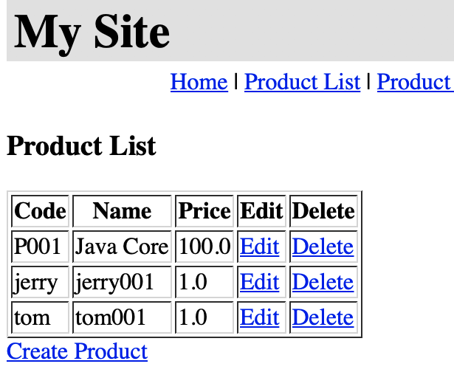
Result
Notes:
The proposed ranking is based on years of experience that Gary McGraw acquired by applying touchpoints to many different types of organizations ranging from independent software vendors to huge credit card consortium

Slide 53
SQL Injection - Automation
Most of the situations and techniques presented here can be performed in an automated way.
An example of such tools is SQLMap
https://www.owasp.org/index.php/Automated_Audit_using_SQLMap
Notes:
The proposed ranking is based on years of experience that Gary McGraw acquired by applying touchpoints to many different types of organizations ranging from independent software vendors to huge credit card consortium

Slide 54
Remediation Techniques

Slide 55

Immutable Queries
Best defense against SQL Injection
They either do not have data that could be interpreted
They treat data as asingle entity that is bound to a column without interpretation
Notes:
The proposed ranking is based on years of experience that Gary McGraw acquired by applying touchpoints to many different types of organizations ranging from independent software vendors to huge credit card consortium

Slide 56
Parameterized Queries
Prepared statements ensure that an attacker is not able to change the intent of a query even if SQL commands are inserted by an attacker. In the safe example below
The parameterized query would not be vulnerable and would instead look for a username which literally matched the entire string
tom’ or ‘1’=‘1
Notes:
The proposed ranking is based on years of experience that Gary McGraw acquired by applying touchpoints to many different types of organizations ranging from independent software vendors to huge credit card consortium

Slide 57
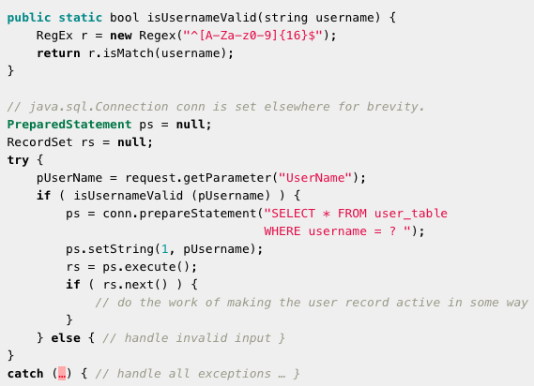
Parameterized Queries - Example
Notes:
The proposed ranking is based on years of experience that Gary McGraw acquired by applying touchpoints to many different types of organizations ranging from independent software vendors to huge credit card consortium

Slide 58
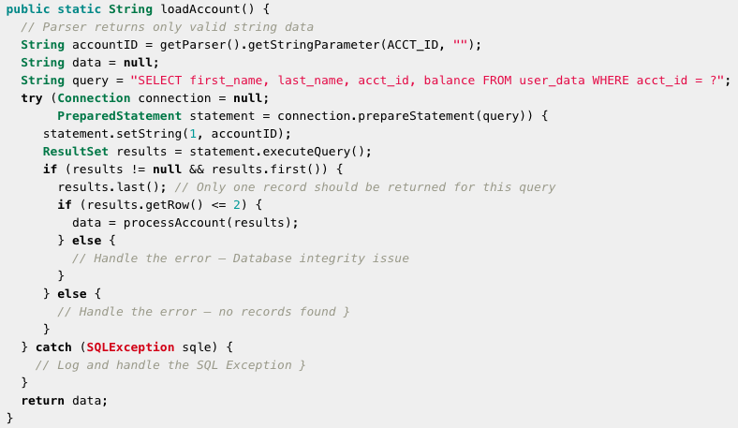
Parameterized Queries - Example
Notes:
The proposed ranking is based on years of experience that Gary McGraw acquired by applying touchpoints to many different types of organizations ranging from independent software vendors to huge credit card consortium

Slide 59
Stored Procedures
The difference between prepared statements and stored procedures is that the SQL code for a stored procedure is defined and stored in the database itself, and then called from the application.
DELIMITER //
CREATE PROCEDURE query(IN uName VARCHAR(20), IN pwd VARCHAR(20))
BEGIN
SELECT USER_NAME, PASSWORD FROM USER_ACCOUNT
WHERE USER_NAME = uNAME AND
PASSWORD = pwd;
END //
Notes:
The proposed ranking is based on years of experience that Gary McGraw acquired by applying touchpoints to many different types of organizations ranging from independent software vendors to huge credit card consortium

Slide 60
Validate Your Input/Output
Does your input contain characters and words that are often used in SQLInjection inputs?
’, +, #, --, JOIN, UNION,;
Check whether the number of outputs returned by a database query is not bigger or smaller than expected.
Notes:
The proposed ranking is based on years of experience that Gary McGraw acquired by applying touchpoints to many different types of organizations ranging from independent software vendors to huge credit card consortium

